Slide 1
Side Project
Machine Translation
NLP2022
ViVi

Slide 2
CONTENT
1 | Introduction
2 | Neural Machine Translation
3 | Transformer for NMT
4 | Decoding in NMT
5 | NMT using Pre-Trained LMs
6 | Experiment
7 | Current Challenges

Slide 3

1 – Introduction
Goal: Translate a sentence w^{(s)} in a source language (input) to a sentence w^{(t)} in the target language (output)

Slide 4
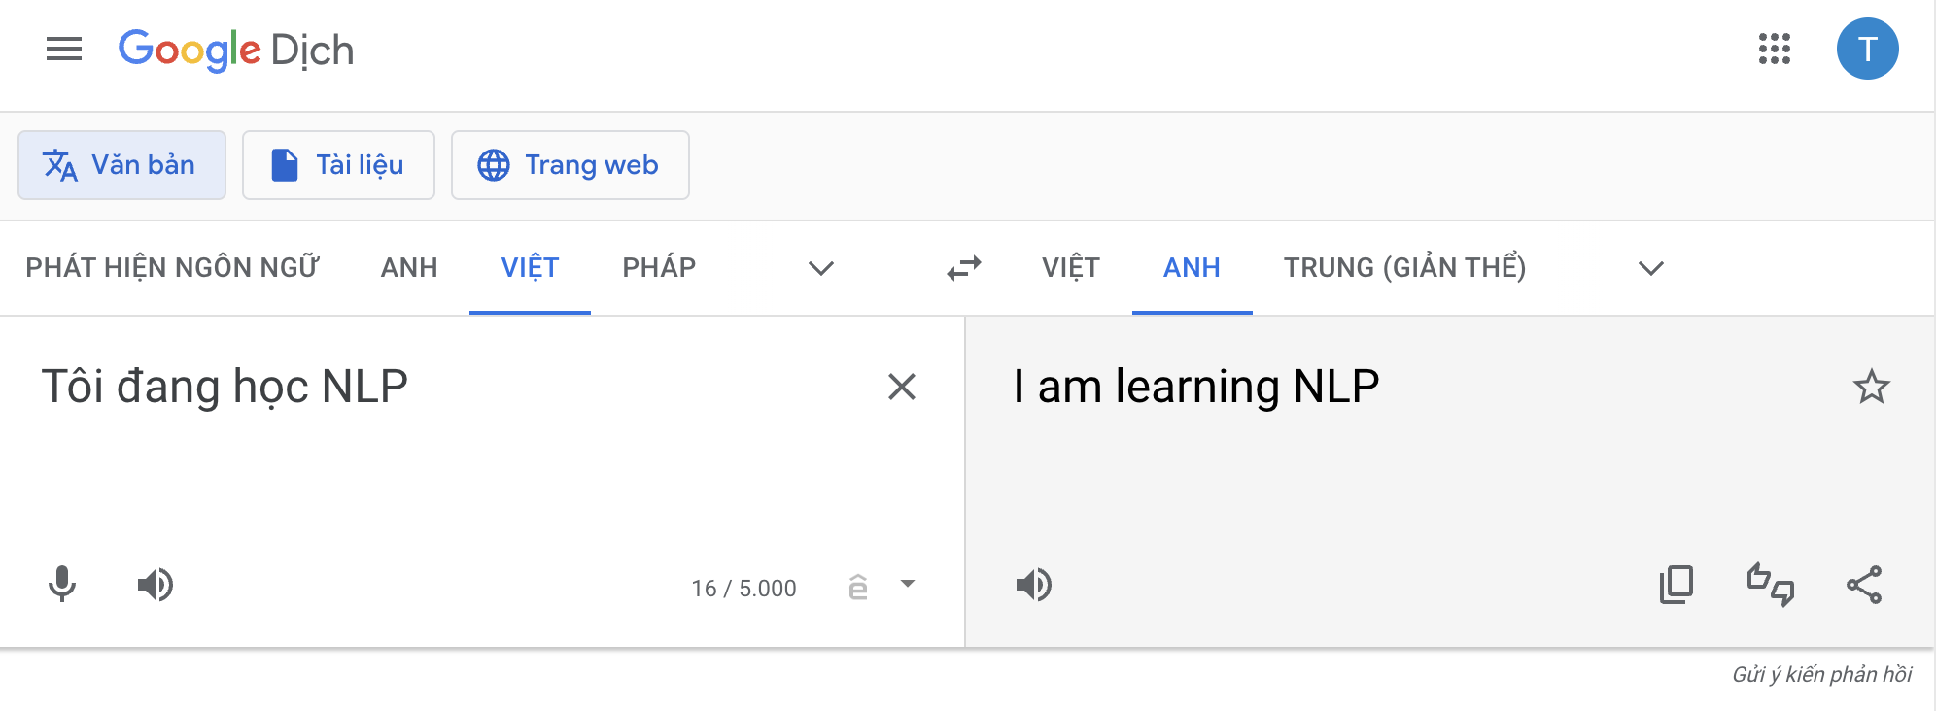
1 – Introduction
Goal: Translate a sentence w^{(s)} in a source language (input) to a sentence w^{(t)} in the target language (output)

Slide 5
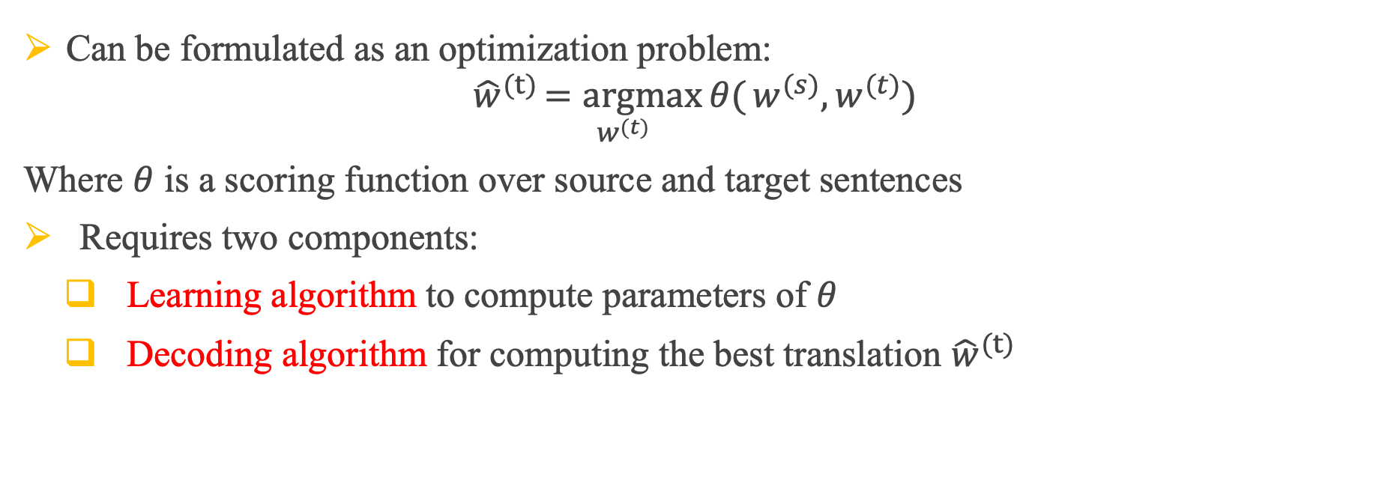
1 – Introduction
Goal: Translate a sentence w^{(s)} in a source language (input) to a sentence w^{(t)} in the target language (output)
Can be formulated as an optimization problem:
$${\hat{w}}^{(t)}\underset{w^{(t)}}{=argmax}{θ(}w^{(s)}, w^{(t)})$$
Where $θ$ is a scoring function over source and target sentences
Requires two components:
Learning algorithm to compute parameters of $θ$
Decoding algorithm for computing the best translation ${\hat{w}}^{(t)}$

Slide 6
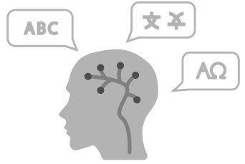


1 – Introduction
Goal: Translate a sentence w^{(s)} in a source language (input) to a sentence w^{(t)} in the target language (output)
Automatic Speech Recognition (ASR)
translation of spoken language into text
Natural Language Understanding (NLU)
a computer’s ability to understand language
Syntax
Semantics
Phonology
Pragmatics
Morphology
Natural Language Generation (NLG)
generate natural language by a computer

Slide 7
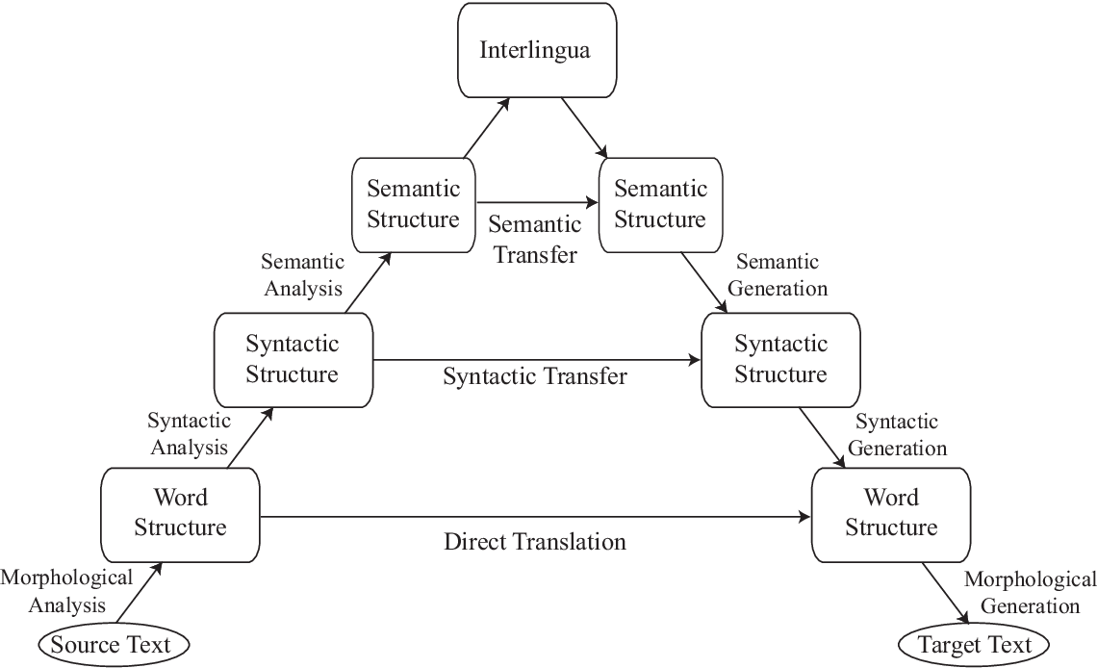
1 – Introduction
Hierarchy of concepts and distances between them in different languages
Lowest level: individual words/characters
Higher levels: syntax, senmantics
Interlingua: generic language-agnostic representation of meaning

Slide 8
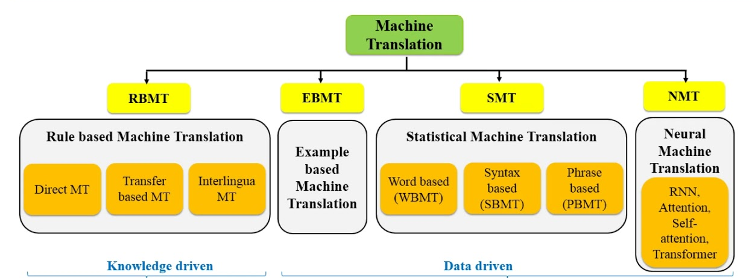
1 – Introduction
1950
1980
1990
2007
2015

Slide 9
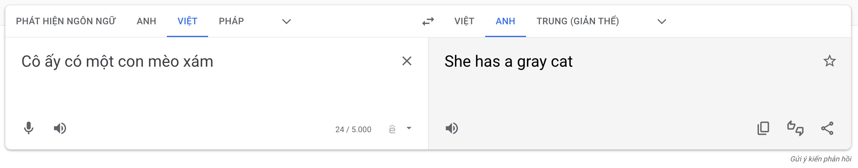
1 – Introduction
1.1 Machine Translation Problems
Syntactic Translation Problems
Reordering of phrases

Slide 10
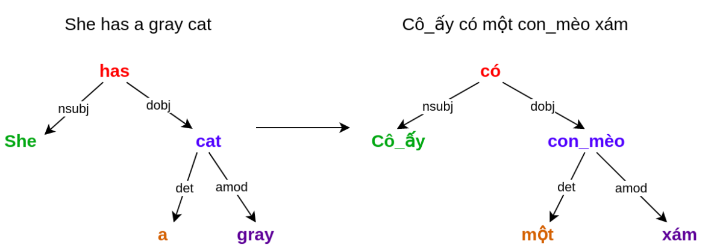
1 – Introduction
1.1 Machine Translation Problems
Syntactic Translation Problems
Reordering of phrases

Slide 11
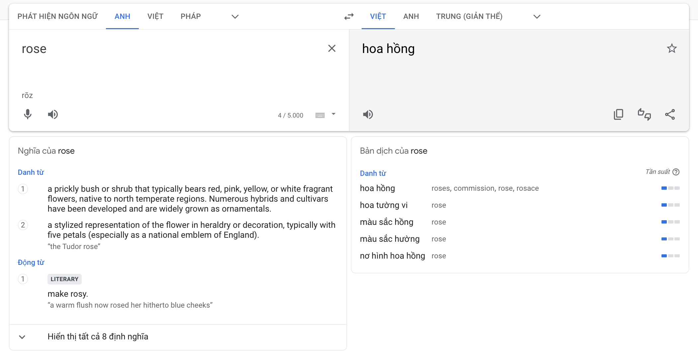
1 – Introduction
1.1 Machine Translation Problems
Semantic Translation Problems

Slide 12
1 – Introduction
1.1 Machine Translation Problems
Semantic Translation Problems
Words are ambiguous, variations:
“Con ngựa đá con ngựa đá”
“Ba tôi đang đi làm”
“Năm nay tôi vào lớp ba”
Single words may be replaced with multi-word phrases
“rose” <=> “hoa hồng”

Slide 13
1 – Introduction
1.1 Machine Translation Problems
Semantic Translation Problems
What is the best translation?
How do we find the right meaning, and thus translation?
Context should be helpful
Tôi đang học NLP | I am studying NLP
 | I am learning NLP

Slide 14
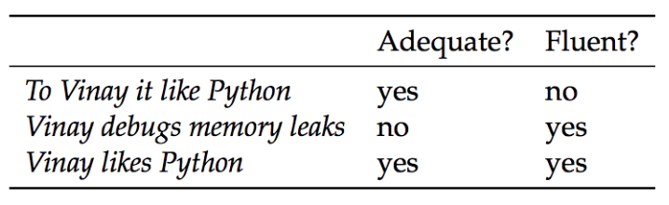
1 – Introduction
1.2 - Evaluating translation quality
Human judgement
Given: machine translation output
Given: source / reference translation
Task: assess the quality of machine translation output
Different translations of “A Vinay le gusta Python”

Slide 15
1 – Introduction
1.2 - Evaluating translation quality
Two main criteria:
Adequacy: Translation w^{(t)} should adequately reflect the linguistic content of w^{(s)}
Fluency: Translation w^{(t)} should be fluent text in the target language
Different translations of “A Vinay le gusta Python”

Slide 16
1 – Introduction
1.2 - Evaluating translation quality
Two main criteria:
Adequacy: Translation w^{(t)} should adequately reflect the linguistic content of w^{(s)}
Fluency: Translation w^{(t)} should be fluent text in the target language
Adequacy and fluency: Sale
Adequancy
5 | All meaning
4 | Most meaning
3 | Much meaning
2 | Little meaning
1 | None
Fluency
5 | Flawless English
4 | Good English
3 | Non-native English
2 | Disfluent English
1 | Incomprehensible

Slide 17
1 – Introduction
1.3 - Evaluating metrics
Manual evaluation is most accurate, but expensive
Automated evaluation metrics:
Compare system hypothesis with reference translations
BLEU Score (BiLingual Evaluation Understudy): Modified n-gram Precision
SacreBLEU Score (A Call for Clarity in Reporting BLEU Scores)

Slide 18
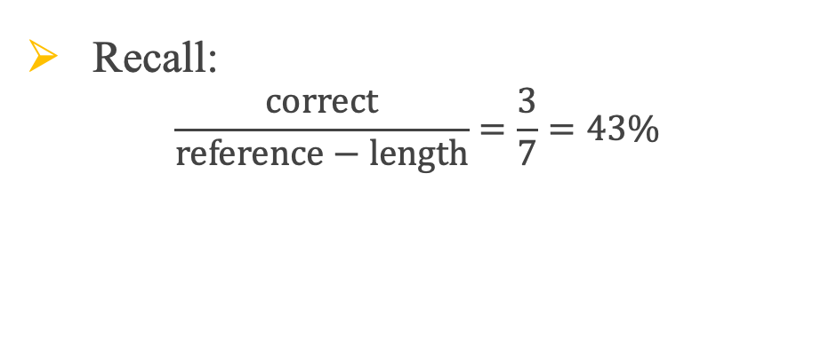
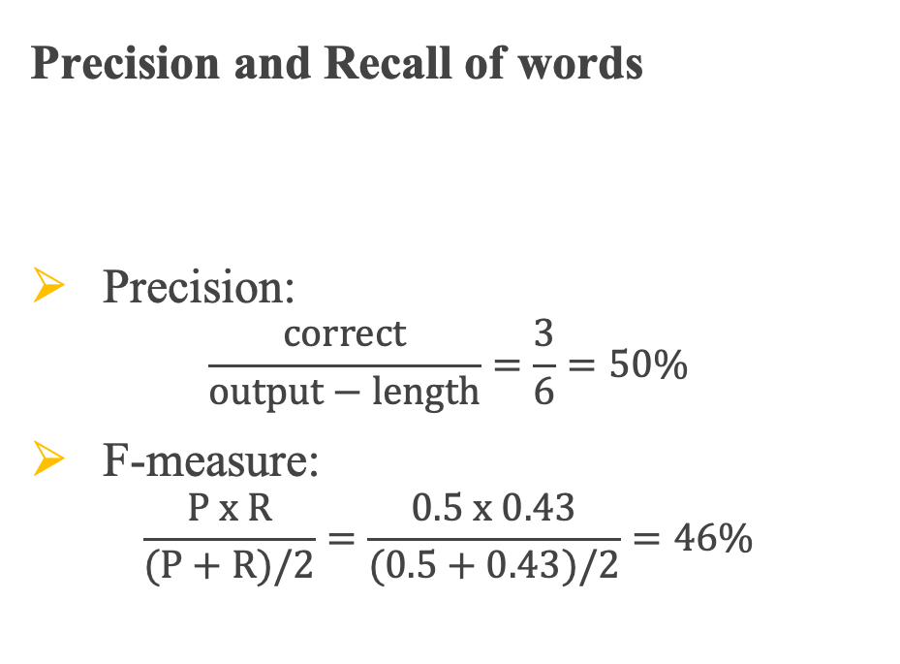
1 – Introduction
1.3 - Evaluating metrics
Precision and Recall of words
Precision:
$$\frac{correct}{output−length}=\frac{3}{6}=50\%$$
F-measure:
$$\frac{P x R}{(P+R)/2}=\frac{0.5 x 0.43}{(0.5+0.43)/2}=46\%$$
System A | A | officials | responsibility | of | airport | safety
Reference | A | officials | are | responsible | for | airport | security
Recall:
$$\frac{correct}{reference−length}=\frac{3}{7}=43\%$$

Slide 19
1 – Introduction
1.3 - Evaluating metrics
Precision and Recall of words
Flaw: no penalty for reordering
System A | A | officials | responsibility | of | airport | safety
Reference | A | officials | are | responsible | for | airport | security
System B | airport | security | A | officials | are | responsible
Metric | System A | System B
Precision | 50% | 100%
Recall | 43% | 100%
F-measure | 46% | 100%

Slide 20
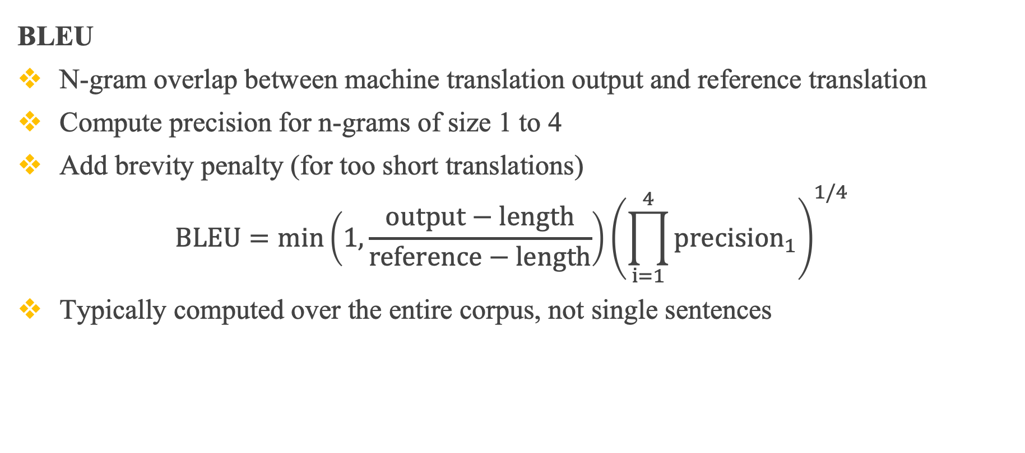
1 – Introduction
1.3 - Evaluating metrics
BLEU
N-gram overlap between machine translation output and reference translation
Compute precision for n-grams of size 1 to 4
Add brevity penalty (for too short translations)
$$BLEU=\min\left(1,\frac{output−length}{reference−length}\right){\left(\prod_{i=1}^{4}{{precision}_{1}}\right)}^{1/4}$$
Typically computed over the entire corpus, not single sentences

Slide 21
1 – Introduction
1.3 - Evaluating metrics
BLEU
1-gram
System A | A | officials | responsibility | of | airport | safety
Reference | A | officials | are | responsible | for | airport | security
System B | airport | security | A | officials | are | responsible
Metric | System A | System B
Precision (1 gram) | 3/6 | 6/6
Precision (2 gram)
Precision (3 gram)
Precision (4 gram)
Brevity penalty
BLEU

Slide 22
1 – Introduction
1.3 - Evaluating metrics
BLEU
System A | A | officials | responsibility | of | airport | safety
Reference | A | officials | are | responsible | for | airport | security
System B | airport | security | A | officials | are | responsible
2 -gram
Metric | System A | System B
Precision (1 gram) | 3/6 | 6/6
Precision (2 gram) | 1/5 | 4/5
Precision (3 gram) | 0/4 | 2/4
Precision (4 gram) | 0/3 | 1/4
Brevity penalty | 6/7 | 6/7
BLEU | 0 | 0.52

Slide 23
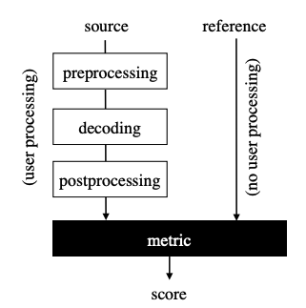
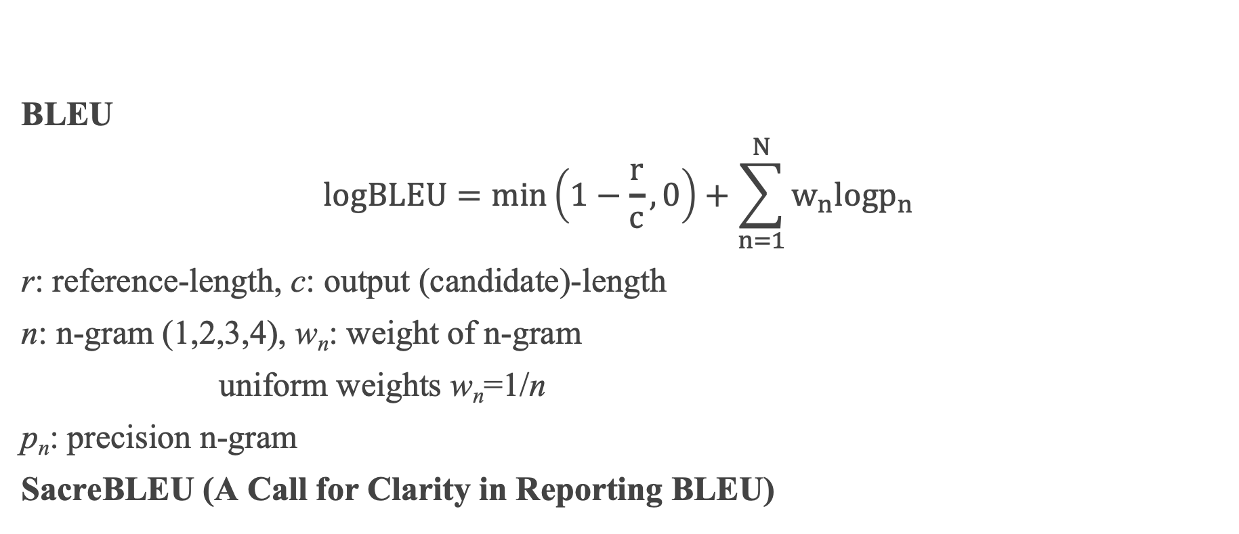
1 – Introduction
1.3 - Evaluating metrics
BLEU
$$logBLEU=min\left(1−\frac{r}{c},0\right)+\sum_{n=1}^{N}{w_{n}logp_{n}}$$
r: reference-length, c: output (candidate)-length
n: n-gram (1,2,3,4), w_{n}: weight of n-gram
uniform weights w_{n}=1/n
p_{n}: precision n-gram
SacreBLEU (A Call for Clarity in Reporting BLEU)

Slide 24
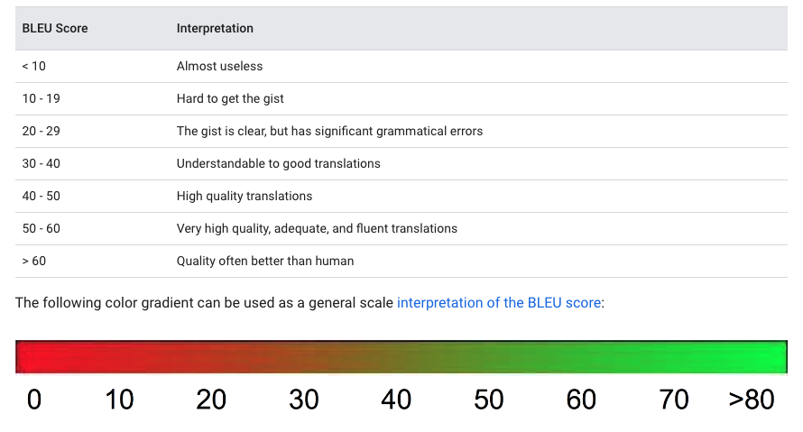
1 – Introduction
1.3 - Evaluating metrics
BLEU

Slide 25
2 – Neural Machine Translation
1950
1980
1990
2007
2015

Slide 26
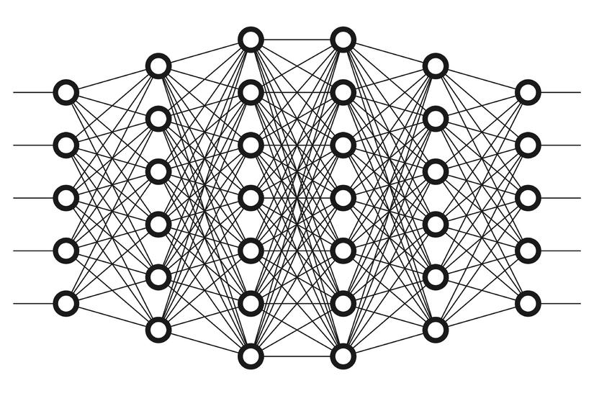
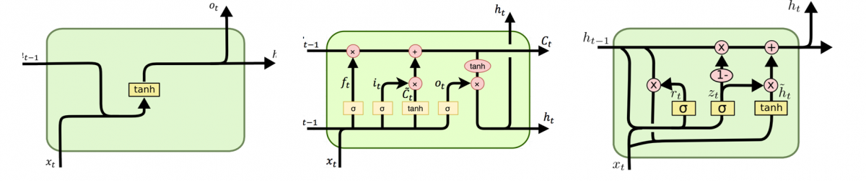
2 – Neural Machine Translation
Motivation

Slide 27
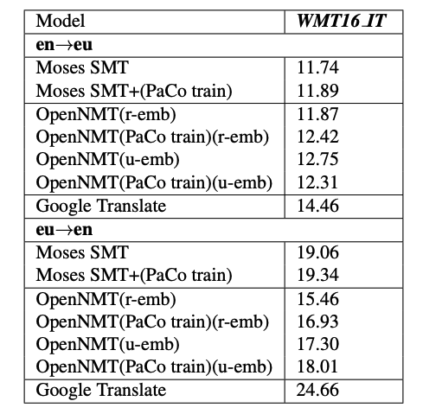
2 – Neural Machine Translation
NMT: The biggest success story of NLP Deep Learning
Neural Machine Translation went from a fringe research activity in 2014 to the leading standard method in 2016
2014: First seq2seq paper published
2016: Google Translate switches from SMT to NMT

Slide 28
2 – Neural Machine Translation
2.1 Sequence to Sequence (Seq2Seq)
A single neural network is used to translate from source to target
Architecture: Encoder-Decoder
Encoder: Convert source sentence (input) into a vector/matrix (State)
Decoder: Convert encoding into a sentence in target language (output)
Decoder
Encoder
Input
State
Output
Thought Vector
Capture all information of input sentence

Slide 29
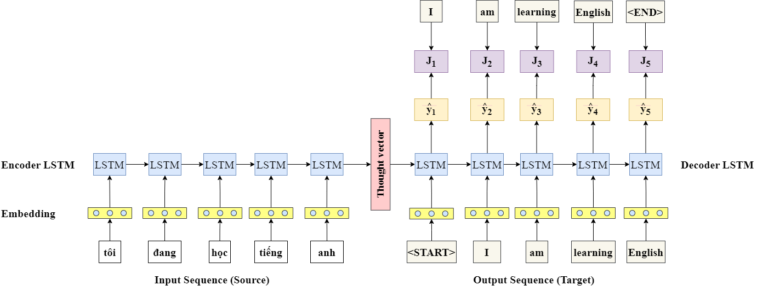
2 – Neural Machine Translation
2.1 Sequence to Sequence (Seq2Seq)
Training

Slide 30
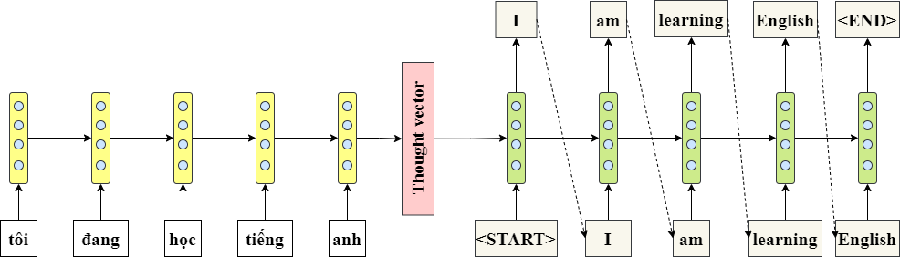
2 – Neural Machine Translation
2.1 Sequence to Sequence (Seq2Seq)
Output Sequence (Target)
Inference
ENCODER
DECODER
Input Sequence (Source)

Slide 31
2 – Neural Machine Translation
2.1 Sequence to Sequence (Seq2Seq)
Information Bottleneck
Solution
Attention
ENCODER
Each step of the decoder, directly connected to the components of the encoder
Focus on all timestep in the encoder
DECODER
Input Sequence (Source)

Slide 32
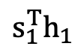
2 – Neural Machine Translation
2.2 Seq2Seq + Attention Schema
Dot-Product Attention
attention score is normalized to length of s (key), called Scaled dot product attention
$$s_{1}^{T}h_{1}$$
Attention Score
Encoder
Decoder
h₁ h₂ h₃ h₄ h₅ s₁
Tôi đang học tiếng anh
<start>

Slide 33
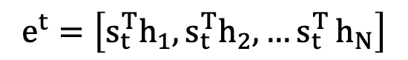
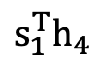
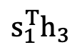
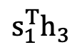
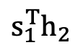
2 – Neural Machine Translation
2.2 Seq2Seq + Attention Schema
$$s_{1}^{T}h_{1}$$
$$s_{1}^{T}h_{2}$$
$$s_{1}^{T}h_{3}$$
$$s_{1}^{T}h_{3}$$
$$s_{1}^{T}h_{4}$$
$$e^{t}=\left[s_{t}^{T}h_{1},s_{t}^{T}h_{2},{…s}_{t}^{T}h_{N}\right]$$
Attention Score
Encoder
Decoder
h₁ h₂ h₃ h₄ h₅ s₁
Tôi đang học tiếng anh
<start>

Slide 34
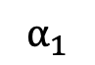
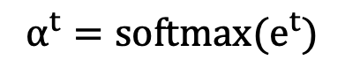
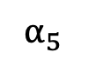
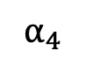
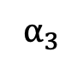
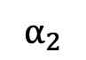
2 – Neural Machine Translation
2.2 Seq2Seq + Attention
$$α_{2}$$
$$α_{3}$$
$$α_{1}$$
$$α_{5}$$
$$α_{4}$$
$$α^{t}=softmax(e^{t})$$
$$s_{1}^{T}h_{1}$$
$$s_{1}^{T}h_{2}$$
$$s_{1}^{T}h_{3}$$
$$s_{1}^{T}h_{3}$$
$$s_{1}^{T}h_{4}$$
Attention Score
Encoder
Decoder
h₁ h₂ h₃ h₄ h₅ s₁
Tôi đang học tiếng anh
<start>

Slide 35
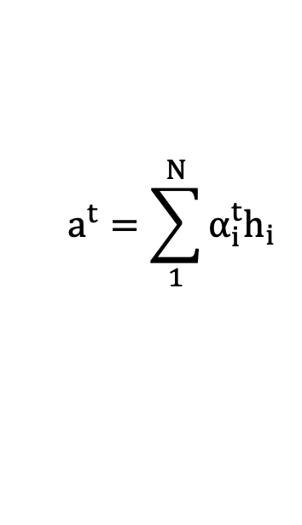
2 – NMT
$$a^{t}=\sum_{1}^{N}{α_{i}^{t}h_{i}}$$
Attention output
2.2 Seq2Seq + Attention
$$α_{2}$$
$$α_{3}$$
$$α_{1}$$
$$α_{5}$$
Attention
distribution
$$α_{4}$$
$$s_{1}^{T}h_{1}$$
$$s_{1}^{T}h_{2}$$
$$s_{1}^{T}h_{3}$$
$$s_{1}^{T}h_{3}$$
$$s_{1}^{T}h_{4}$$
Attention Score
Encoder
Decoder
h₁ h₂ h₃ h₄ h₅ s₁
Tôi đang học tiếng anh
<start>

Slide 36
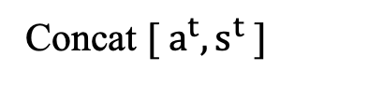
2 – NMT
2.2 Seq2Seq + Attention
Attention output
I
$$α_{2}$$
$$α_{3}$$
$$α_{1}$$
$$α_{5}$$
Attention
distribution
$$α_{4}$$
Concat $[ a^{t},s^{t} ]$
$$s_{1}^{T}h_{1}$$
$$s_{1}^{T}h_{2}$$
$$s_{1}^{T}h_{3}$$
$$s_{1}^{T}h_{3}$$
$$s_{1}^{T}h_{4}$$
Attention Score
Encoder
Decoder
h₁ h₂ h₃ h₄ h₅ s₁
Tôi đang học tiếng anh
<start>

Slide 37
2 – NMT
2.2 Seq2Seq + Attention
Attention output
I
$$α_{2}$$
$$α_{3}$$
$$α_{1}$$
$$α_{5}$$
Attention
distribution
$$α_{4}$$
Concat $[ a^{t},s^{t} ]$
$$s_{1}^{T}h_{1}$$
$$s_{1}^{T}h_{2}$$
$$s_{1}^{T}h_{3}$$
$$s_{1}^{T}h_{3}$$
$$s_{1}^{T}h_{4}$$
Attention Score
Encoder
Decoder
h₁ h₂ h₃ h₄ h₅ s₁
Tôi đang học tiếng anh
<start>

Slide 38
2 – NMT
2.2 Seq2Seq + Attention
Attention output
<end>
Attention
distribution
Attention Score
Encoder
Decoder
h₁ h₂ h₃ h₄ h₅ s₁ s₂ s₃ s₄ s₅
Tôi đang học tiếng anh
<start> I am learning english

Slide 39
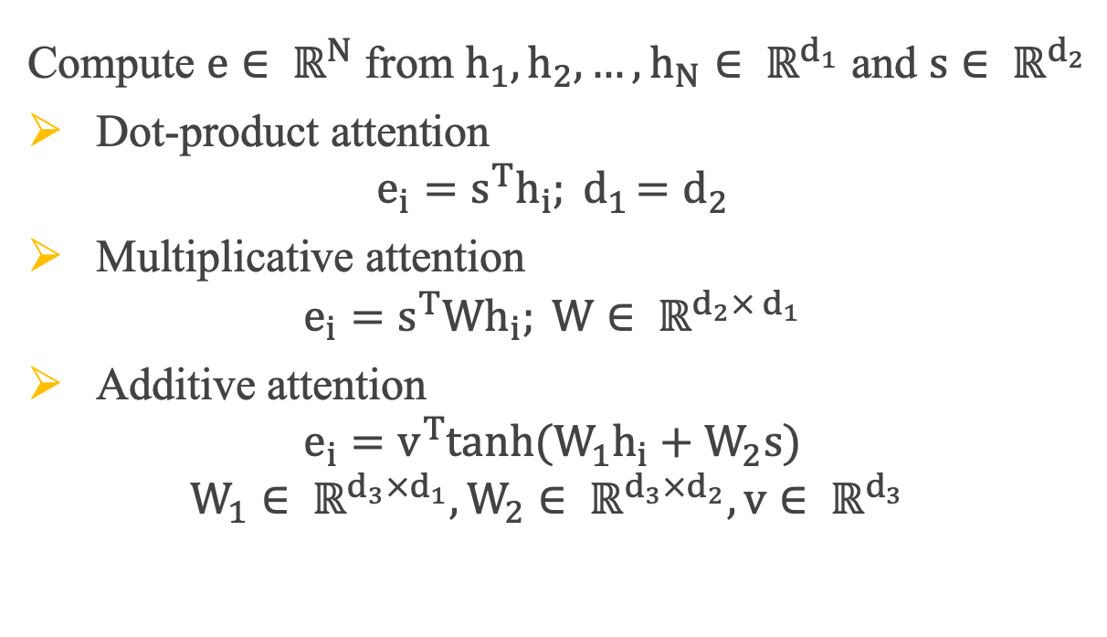
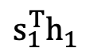
2 – Neural Machine Translation
2.2 Seq2Seq + Attention Schema
Compute $e∈ ℝ^{N}$ from $h_{1}, h_{2},…, h_{N}∈ ℝ^{d_{1}}$ and $s∈ ℝ^{d_{2}}$
Dot-product attention
$$e_{i}=s^{T}h_{i}{; d}_{1}=d_{2}$$
Multiplicative attention
$$e_{i}=s^{T}Wh_{i}; W∈ ℝ^{d_{2}× d_{1}}$$
Additive attention
$$e_{i}=v^{T}tanh(W_{1}h_{i}+W_{2}s)$$
$$W_{1}∈ ℝ^{d_{3}×d_{1}},W_{2}∈ ℝ^{d_{3}×d_{2}}, v∈ ℝ^{d_{3}}$$
Dot-Product Attention
$$s_{1}^{T}h_{1}$$
Attention Score
Encoder
Decoder

Slide 40
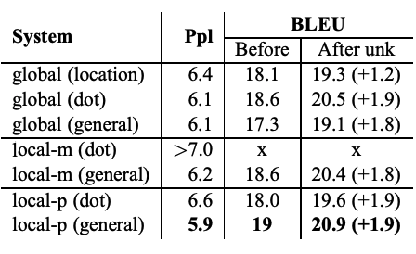
2 – Neural Machine Translation
2.2 Seq2Seq + Attention Schema
Compute $e∈ ℝ^{N}$ from $h_{1}, h_{2},…, h_{N}∈ ℝ^{d_{1}}$ and $s∈ ℝ^{d_{2}}$
Dot-product attention
$$e_{i}=s^{T}h_{i}{; d}_{1}=d_{2}$$
Multiplicative attention
$$e_{i}=s^{T}Wh_{i}; W∈ ℝ^{d_{2}× d_{1}}$$
Additive attention
$$e_{i}=v^{T}tanh(W_{1}h_{i}+W_{2}s)$$
$$W_{1}∈ ℝ^{d_{3}×d_{1}},W_{2}∈ ℝ^{d_{3}×d_{2}}, v∈ ℝ^{d_{3}}$$

Slide 41

2 – Neural Machine Translation
2.3 Transformer
Architecture:
Token Embedding
Positional Embedding
N x Encoder Layer:
N x Decoder Layer
Core technique: Self-Attention

Slide 42
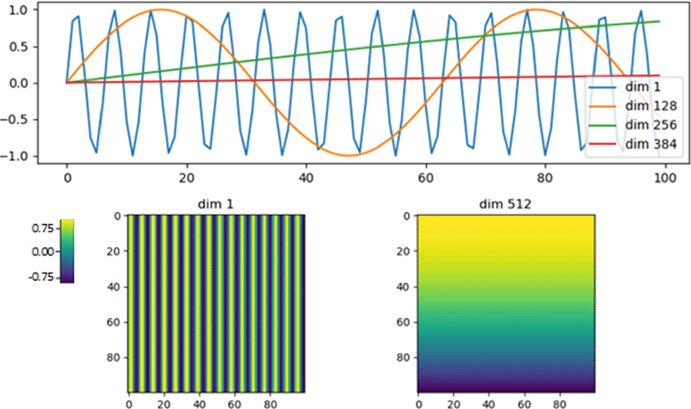
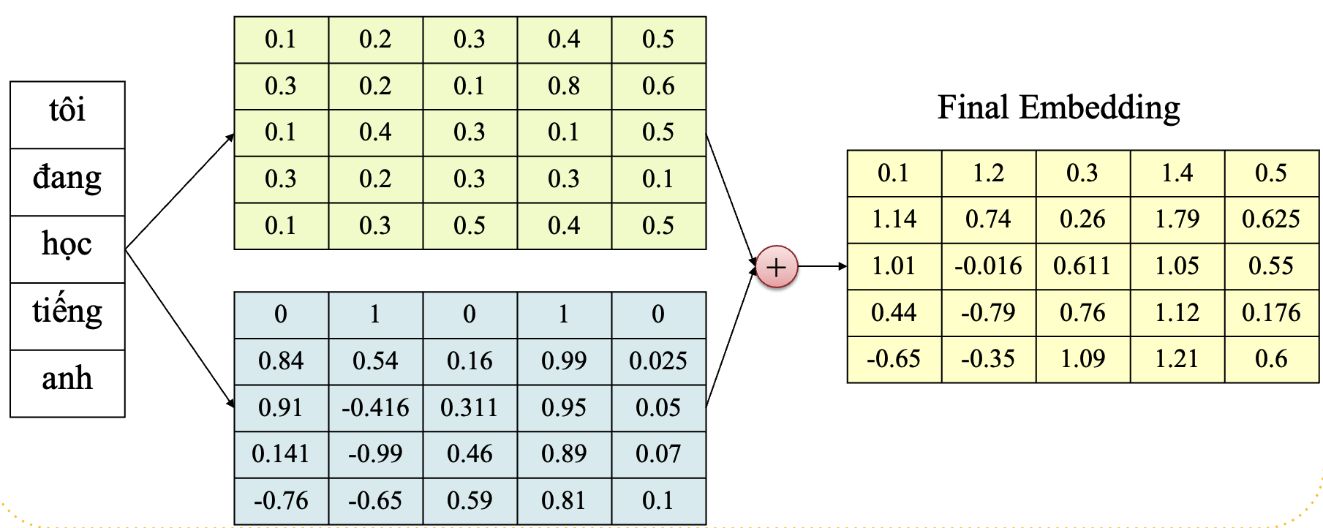

2 – Neural Machine Translation
2.3 Transformer
Input Embedding
Positional Encoding: Sinusoid

Slide 43

2 – Neural Machine Translation
2.3 Transformer
Multi-Head Attention

Slide 44
2 – Neural Machine Translation
2.3 Transformer
Merge
Multi-Head Attention
Attention Score
Heads
Heads
Heads
Seq
Split
Emb
Split
Emb
Split
Emb
Seq
Seq
Seq
Linear
Linear
Linear
Seq x Embed

Slide 45
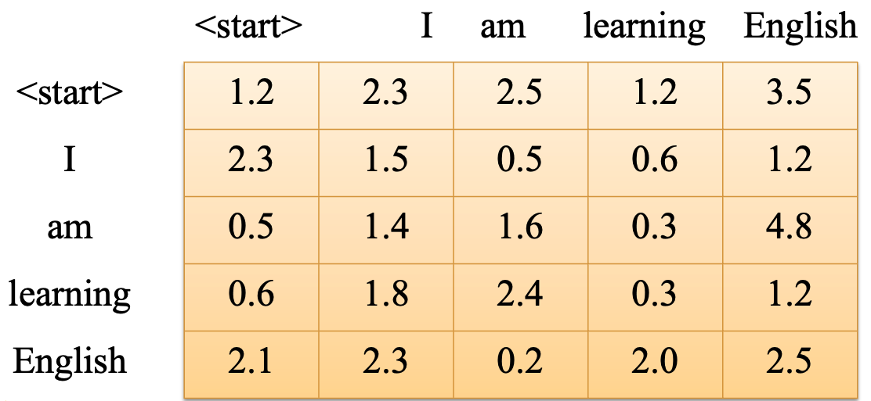
2 – Neural Machine Translation
2.3 Transformer
Masked Multi-Head Attention
Predict next token based on the history token
Not Seen

Slide 46
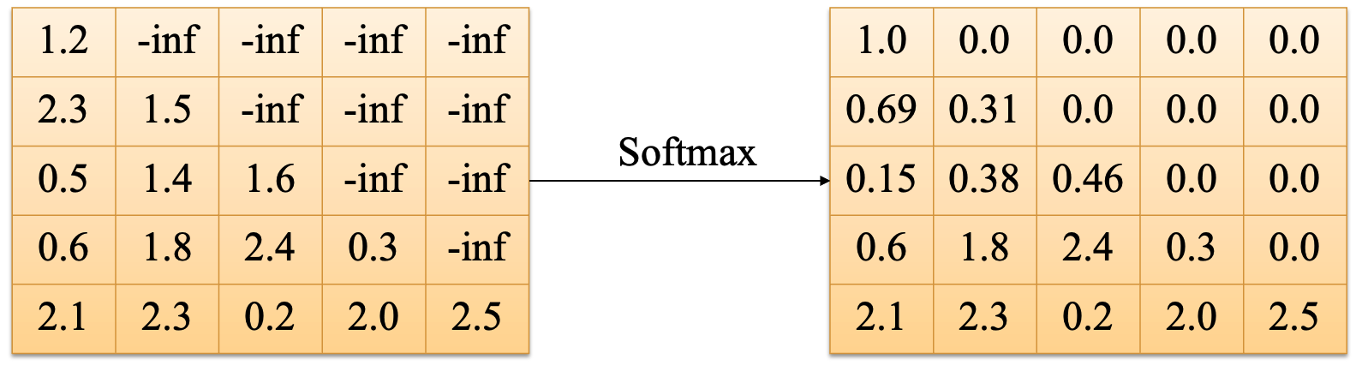
2 – Neural Machine Translation
2.3 Transformer
Masked Multi-Head Attention
Predict next token based on the history token

Slide 47
2 – Neural Machine Translation
2.3 Transformer

Slide 48
3 – Transformer for NMT
Tokenizer: SentencePiece
Target
I | go | to | work | <end>
Loss
Prediction
I | go | _earn | work | <end>
t
_ôi
đi
l
_àm
ENCODER
DECODER
<start> | I | go | to | work

Slide 49
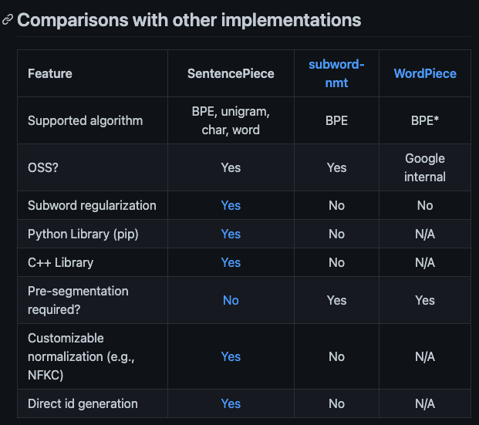
3 – Transformer for NMT
Tokenizer: SentencePiece
t
_ôi
đi
l
_àm
Tôi đi làm

Slide 50
4 – Decoding in NMT
How to choose “Best candidate”
Output Sequence (Target)
ENCODER
DECODER
Input Sequence (Source)

Slide 51
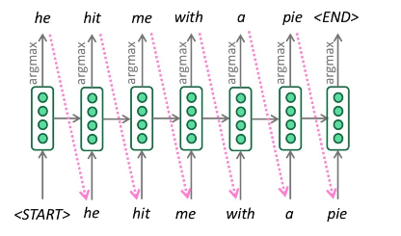
4 – Decoding in NMT
4.1 Greedy Decoding
Compute argmax at every step of decoder to generate token

Slide 52
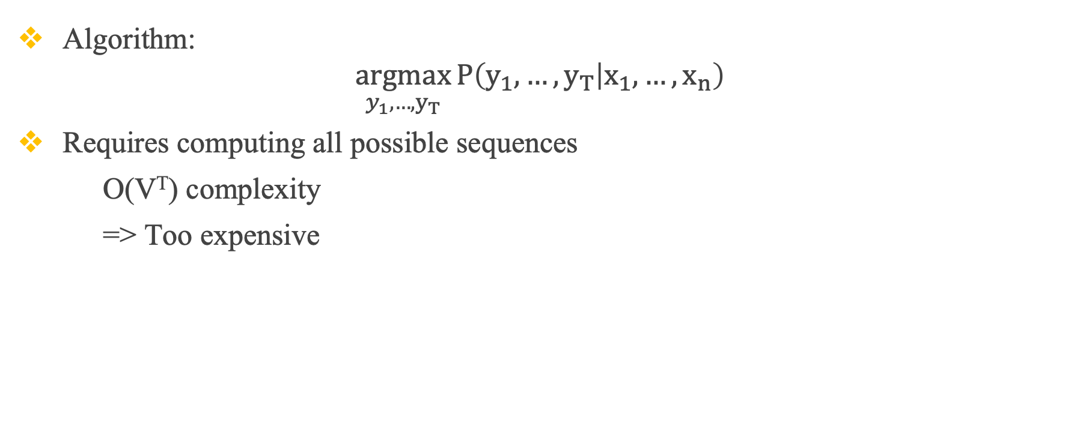
4 – Decoding in NMT
4.2 Exhaustive Search
Algorithm:
$$\underset{y_{1},…,y_{T}}{argmax}{P\left(y_{1},…,y_{T} | x_{1},…,x_{n}\right)}$$
Requires computing all possible sequences
O(V^{T}) complexity
=> Too expensive

Slide 53
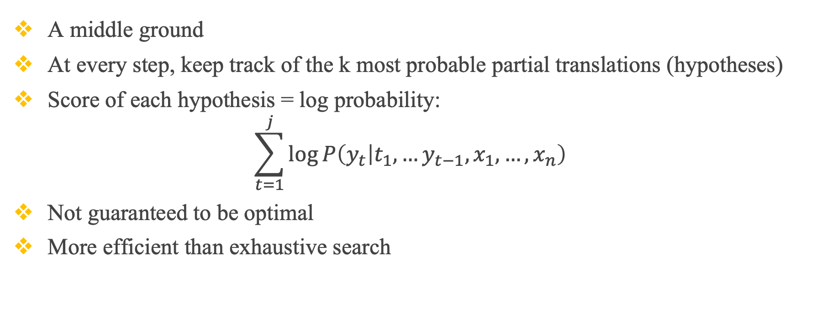
4 – Decoding in NMT
4.3 Beam Search
A middle ground
At every step, keep track of the k most probable partial translations (hypotheses)
Score of each hypothesis = log probability:
$$\sum_{t=1}^{j}{\log{P\left(y_{t} | t_{1},…y_{t−1},x_{1},…,x_{n}\right)}}$$
Not guaranteed to be optimal
More efficient than exhaustive search

Slide 54
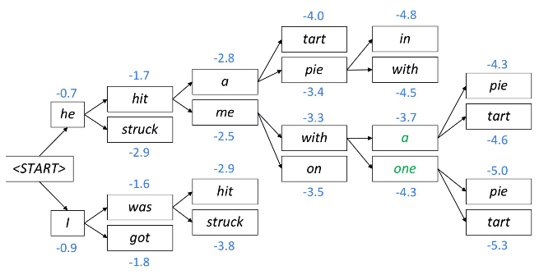
4 – Decoding in NMT
4.3 Beam Search
Beam size = 2

Slide 55
4 – Decoding in NMT
4.3 Beam Search
Beam size = 2

Slide 56
4 – Decoding in NMT
4.3 Beam Search
Beam size = 2

Slide 57
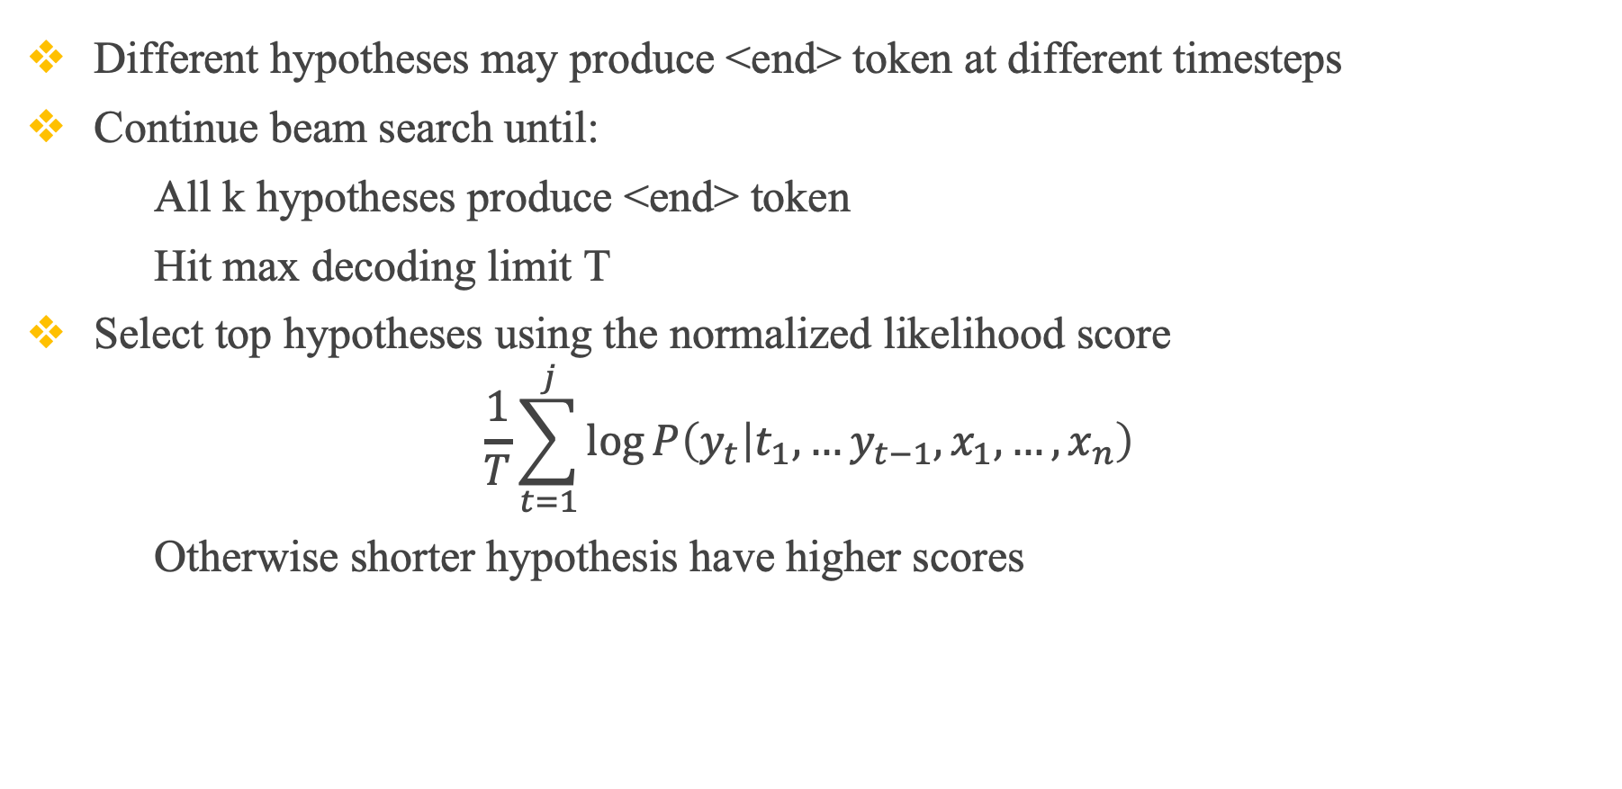
4 – Decoding in NMT
4.3 Beam Search
Different hypotheses may produce <end> token at different timesteps
Continue beam search until:
All k hypotheses produce <end> token
Hit max decoding limit T
Select top hypotheses using the normalized likelihood score
$$\frac{1}{T}\sum_{t=1}^{j}{\log{P\left(y_{t} | t_{1},…y_{t−1},x_{1},…,x_{n}\right)}}$$
Otherwise shorter hypothesis have higher scores

Slide 58
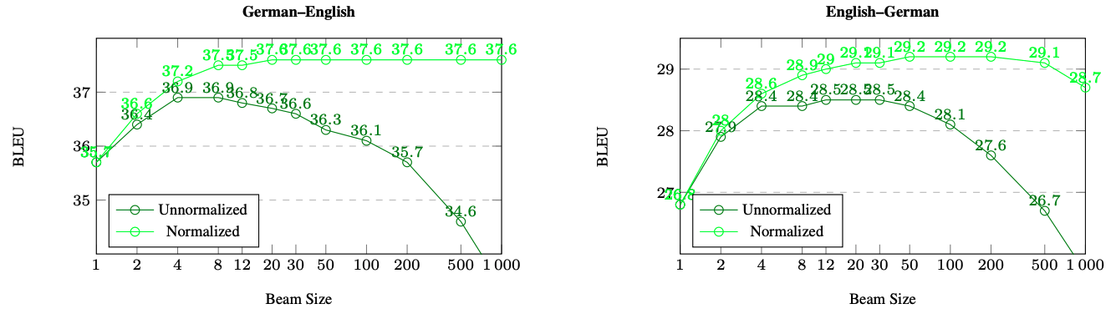
4 – Decoding in NMT
4.3 Beam Search

Slide 59
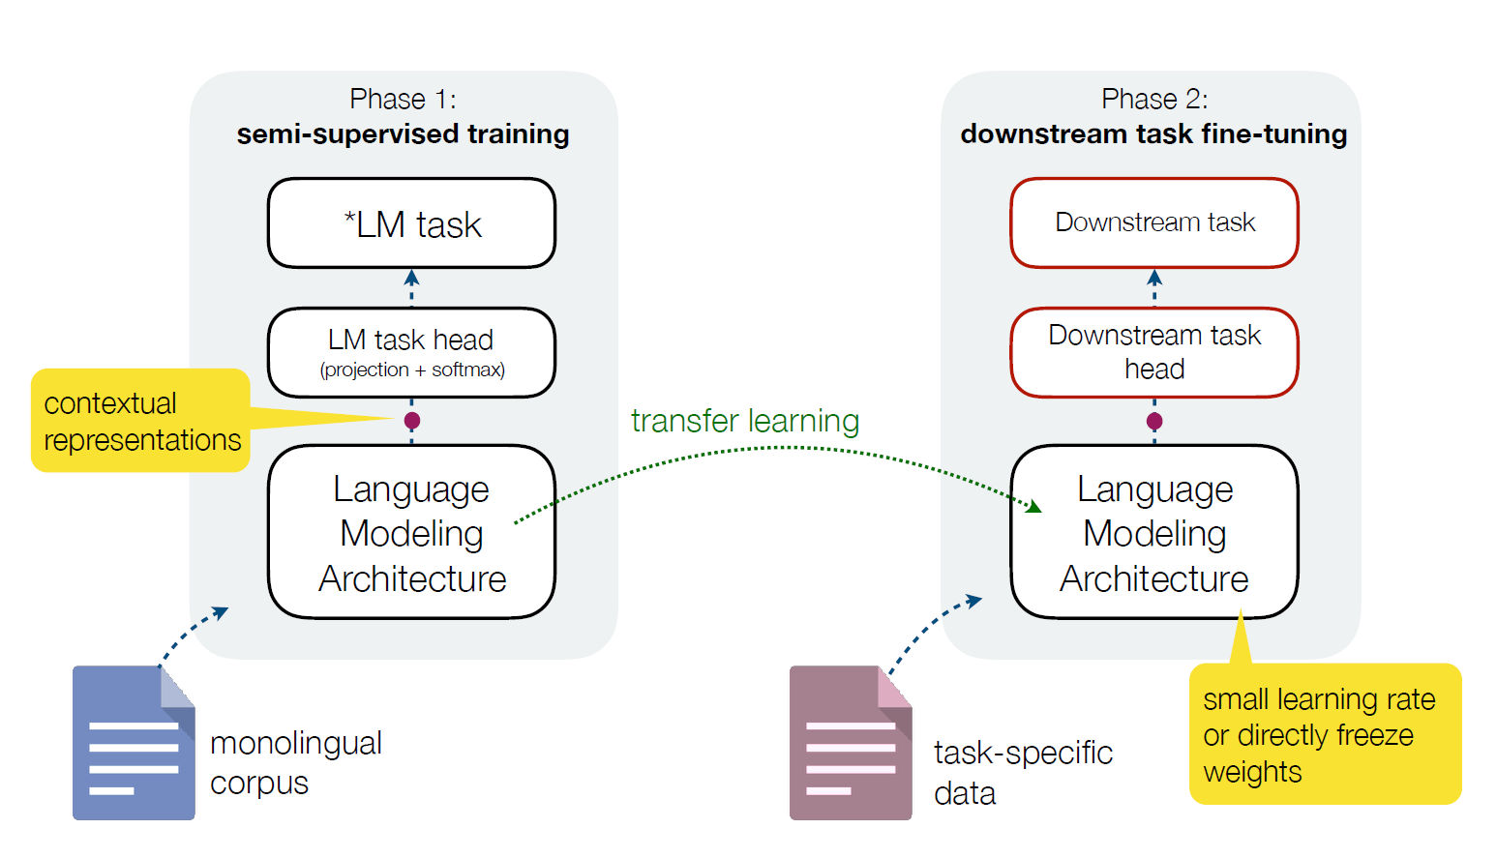

5 –NMT using Pre-Trained LMs
5.1 Pre-Trained Language Model

Slide 60
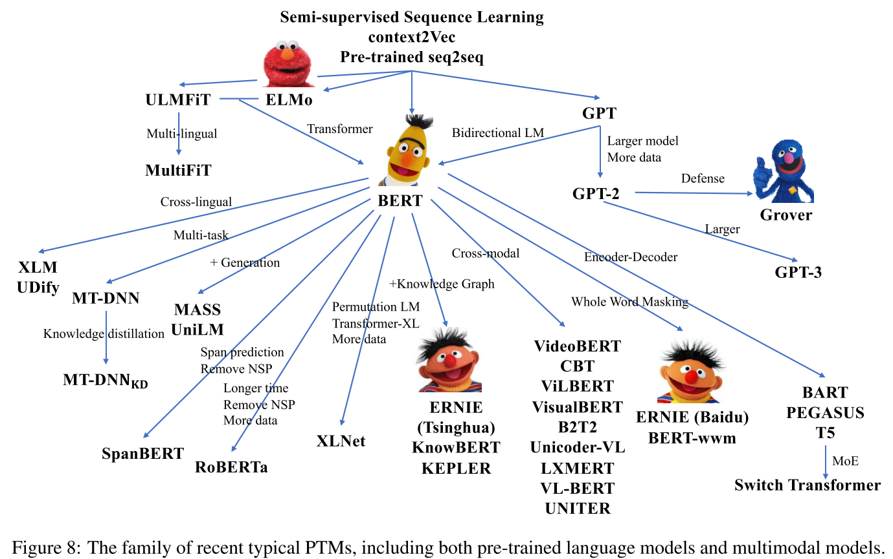
5 –NMT using Pre-Trained LMs
5.1 Pre-Trained Language Model
Source

Slide 61

5 –NMT using Pre-Trained LMs
5.1 Pre-Trained Language Model

Slide 62


5 –NMT using Pre-Trained LMs
5.2. BERT
BERT: An encoder-only model
Maps an input sequence to a contextualized sequence: $f_{θ_{BERT}}:X_{1:n}⟶{\overline{X}}_{1:n}$
Source

Slide 63

5 –NMT using Pre-Trained LMs
5.2. BERT
BERT base:
L=12, H=768, A=12, P=110M
BERT large:
L=24, H=1024, A=16, P=340M
Source

Slide 64

5 –NMT using Pre-Trained LMs
5.2. BERT
Objective Functions:
Masked LM (15% token):
80%: replace with [MASK]
10%: replace with a random word
10%: keep unchanged
Next Sentence Prediction (NSP)
Classification Task
2 Labels: IsNext and NotNext
Use [SEP] token
Source

Slide 65

5 –NMT using Pre-Trained LMs
5.2. BERT
BERT input representation
Source

Slide 66
5 –NMT using Pre-Trained LMs
5.2. BERT
Source

Slide 67


5 –NMT using Pre-Trained LMs
5.2. GPT (GPT2)
GPT2: A decoder-only model, use uni-directional (causal) self-attention
Maps an input sequence to a “next word” logit vector sequence:
$f_{θ_{GPY2}}:X_{0:m−1}⟶L_{1:m}$

Slide 68


5 –NMT using Pre-Trained LMs
5.2. GPT (GPT2)

Slide 69

5 –NMT using Pre-Trained LMs
5.3. Encoder-Decode with BERT and GPT2
Encoder-Decoder Architecture

Slide 70

5 –NMT using Pre-Trained LMs
5.3. Encoder-Decode with BERT and GPT2
BERT for Encoder

Slide 71

5 –NMT using Pre-Trained LMs
5.3. Encoder-Decode with BERT and GPT2
BERT for Decoder

Slide 72

5 –NMT using Pre-Trained LMs
5.3. Encoder-Decode with BERT and GPT2
GPT2 for Decoder

Slide 73

5 –NMT using Pre-Trained LMs
5.3. Encoder-Decode with BERT and GPT2
BERT and GPT2: a great catalyst for NLU
But, less successful for sequence-to-sequence tasks: machine translation, text summarization,…
Missing tokens are predicted independently, soBERT cannot easily be used for generation
Tokens can only condition on leftward context, so it cannot learn bidirectional interactions

Slide 74


5 –NMT using Pre-Trained LMs
5.4. BART (Pretrained Sequence to Sequence)
BART: Denoising Sequence-to-Sequence Pre-Training for Natural Language Generation, Translation and Comprehension

Slide 75

5 –NMT using Pre-Trained LMs
5.4. BART (Pretrained Sequence to Sequence)
Fine-tune BART
Classification Task
Machine Translation Task

Slide 76

5 –NMT using Pre-Trained LMs
5.4. BART (Pretrained Sequence to Sequence)
mBART: Multilingual Denoising Pre-Training

Slide 77

5 –NMT using Pre-Trained LMs
5.4. BART (Pretrained Sequence to Sequence)
mBART50: Multilingual Translation with Extensible Multilingual Pretraining

Slide 78

5 –NMT using Pre-Trained LMs
5.4. BART (Pretrained Sequence to Sequence)
mBART50
PhoMT Dataset

Slide 79
6 - Experiment
6.1. Compare Modes
Dataset: IWSLT’15 English-Vietnamese - Link Code and Model
Training: 133 317 Validation: 1 553 Test: 1 268
Experiment | Model | ScareBLEU
#1 | Standard Transformer (Greedy Search) | 24.66 55.9/30.3/18.5/11.8
#2 | BERT-to-BERT (Greedy Search) | 23.06 48.2/28.0/17.9/11.7
#3 | BERT-to-BERT (Beam Search, Size=5) | 23.72 49.5/28.7/18.4/12.1
#4 | BERT-to-GPT2 (Greedy Search) | 23.56 49.1/28.5/18.4/12.0
#5 | BERT-to-GPT2 (Beam Search, Size=5) | 23.46 48.6/28.3/18.3/12.1
#6 | mBART50 (Greedy Search) | 32.69 64.3/41.3/29.0/20.9
#7 | mBART50 (Beam Search, Size=5) | 34.07 62.8/40.9/29.1/21.2

Slide 80

6 - Experiment
6.1. Compare Models
BERT-BERT Model
Link Code and Model

Slide 81

6 - Experiment
6.1. Compare Models
BERT-GPT2 Model
Link Code and Model

Slide 82

6 - Experiment
6.1. Compare Models
mBART50 Model
Link Code and Model

Slide 83

6 - Experiment
6.2. Beam Search
Model: mBART50 - Link Code and Model
Experiment | Beam Size | ScareBLEU
#1 | 1 (Greedy Search) | 32.69 64.3/41.3/29.0/20.9
#2 | 2 | 33.49 63.7/41.1/29.1/21.1
#3 | 4 | 33.91 63.0/40.8/29.1/21.2
#4 | 6 | 34.16 62.8/40.8/29.1/21.3
#5 | 8 | 34.33 62.8/41.0/29.3/21.4
#6 | 10 | 34.41 62.7/41.0/29.3/21.5
#7 | 12 | 34.39 62.7/41.0/29.3/21.4
#8 | 14 | 34.28 62.5/40.7/29.1/21.3
#9 | 16 | 34.14 62.4/40.6/28.9/21.2
#10 | 18 | 34.21 62.3/40.6/29.0/21.2

Slide 84


7 – Current Challanges
7.1. Domain Mismatch
Source

Slide 85


7 – Current Challanges
7.2. Amount of Training Data
Source
Source

Slide 86


7 – Current Challanges
7.2. Amount of Training Data
Low-resource Machine Translation
Augmentation using Back Translation
More,… Multilingual Machine Translation
Source

Slide 87

7 – Current Challanges
7.2. Amount of Training Data
Low-resource Machine Translation
Source

Slide 88

7 – Current Challanges
7.3. Long Sentences
Source

Slide 89
Thanks!
Any question?

